Slide 1
Dicke model: Tutorial and semiclassical techniques
Jorge Chávez-Carlos
Seminar
Storrs, Connecticut, USA 2024

Slide 2
Outline
Dicke model
Quantum model
Classical limit
Classical dynamics
Lyapunov exponent
LE in the Dicke model
Homework

Slide 3
DICKE MODEL

Slide 4
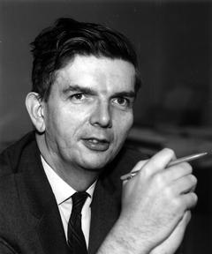
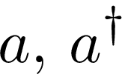
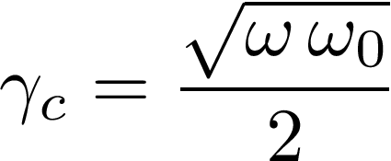
Dicke model
Annihilation and creation operators
Pseudo-espin operators
Number two level atoms
Frequency of mode and atom respectively
Coupling parameter
Critical parameter of coupling
Optical cavity with N two level atoms
Robert H. Dicke
(1916-1997)
Photonic term
Atomic term
Interaction term
R. H. Dicke, Phys. Rev. 93, 99 (1954)

Slide 5
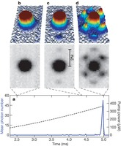
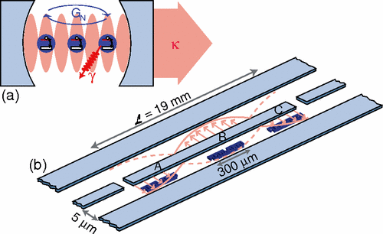
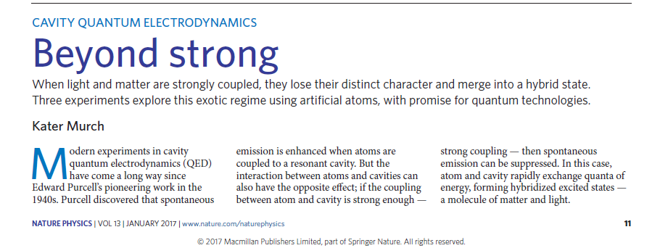
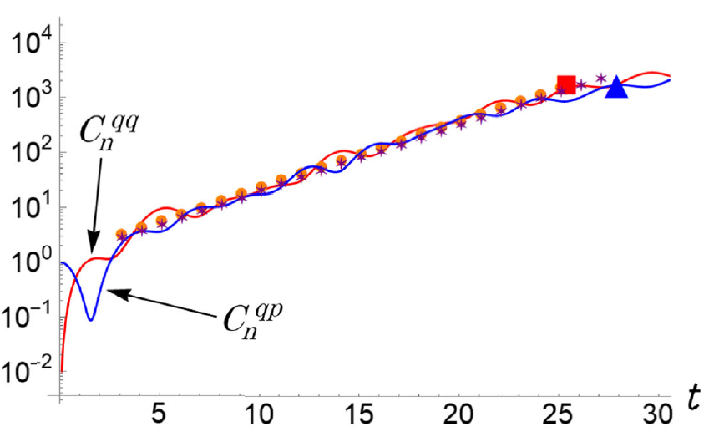
Dicke model
Quantum phase transition observed in Bose-Einstein condensate!!
“Quantum phase transitions and chaos are related”.
Simplier system
Non integrable.
Spectroscopy.
Quantum pase transitions.
Chaos.
Experimentalmentally done in QED for N=3.
Quantum technologies
R. H. Dicke, Phys. Rev. 93, 99 (1954).
Carmichael, H. J., Gardiner, C. W. & Walls, Phys. Lett. A 46, (1973).
C. Emary, T. Brandes, Phys. Rev. E 67, 066203 (2003).
J. M. Fink, et al., Phys. Rev. Lett. 103, 083601 (2009).
Baumann, K., et al, Nature 464, 1301–1306 (2010).
Kater Murch, Nature 13, 11-12 (2017).
J. Chavez-Carlos, et al., Phys. Rev. Lett. 122, 024101 (2019).
D. Villaseñor, et al., arXiv: 2405.20381 (2024)
OTOC

Slide 6
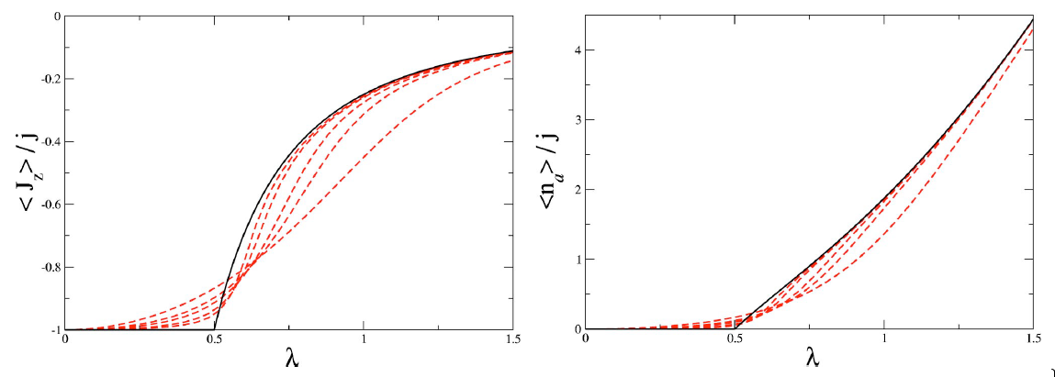
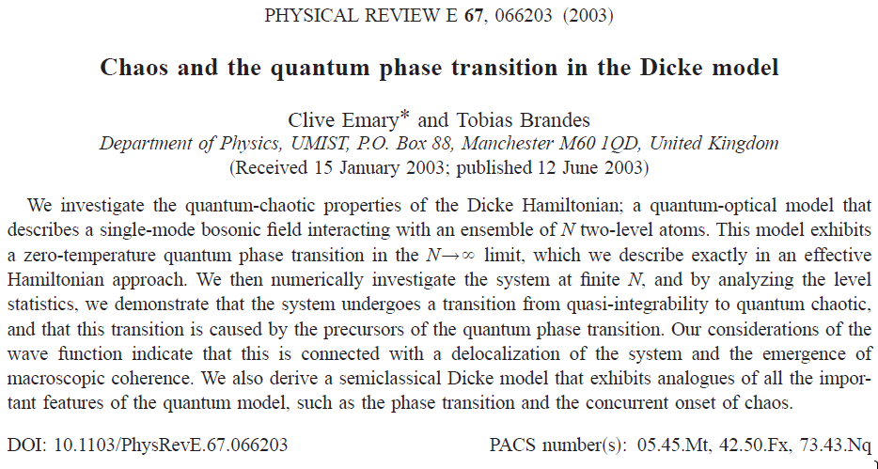
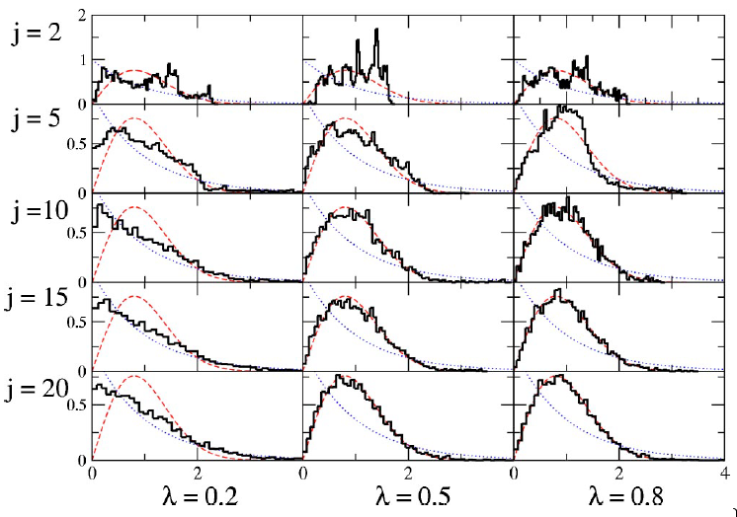
Dicke model
Atomic inversion and expected values of photons. Quantum pase transition (QPT)
λ coupling control parameter, (ω = ω_{o}), λc=0.5.
N = 2 j
C. Emary, T. Brandes, Phys. Rev. E 67, 066203 (2003).
Energy level spacing: distributions Wigner (red) y Poisson (blue)

Slide 7
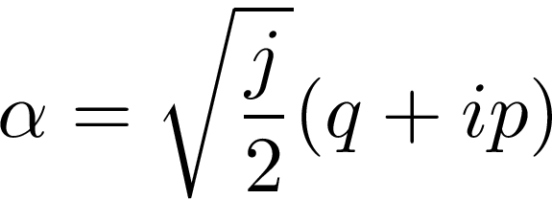
Classical Hamiltonian
Coherent states:
Glauber
SU(2)
Field:
Atoms:
C. Emary, T. Brandes, Phys. Rev. E 67, 066203 (2003)
L. Bakemeier, A. Alvermann, and H. Fehske, Phys. Rev. Lett. 88, 043835 (2013).
M. A. Bastarrachea-Magnani, S. Lerma-Hernandez, and J. G. Hirsch, Phys. Rev. A 89, 032101 (2014).
A. Altland, F. Haake, New J Phys. 14 073011 (2014).

Slide 8
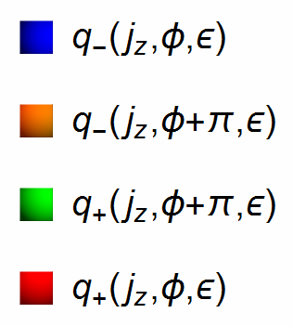
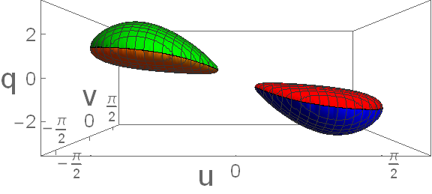
Simetries of the Hamiltonian
Invariance:
p → -p
(φ,q) → (φ+π,-q)
If p = 0
For 2γ_{c}, ω = ω_{o} and p=0

Slide 9
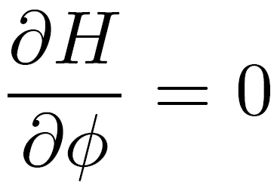
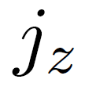
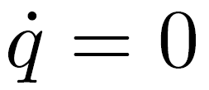
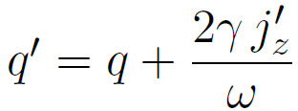
Integrable limits
γ = 0
No dependency of
is constant
ω = 0
No dependency of
is constant
ω_{o} = 0
Rotation
No dependency of
is constant

Slide 10
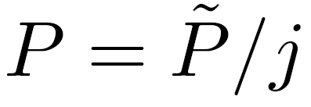
Dynamical analysis
Hamilton equations

Slide 11
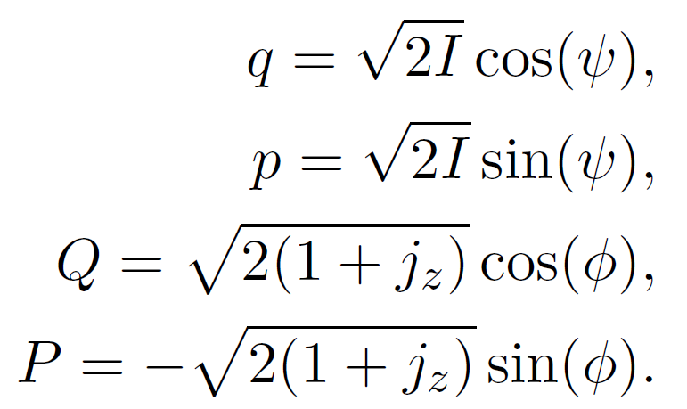
KAM and Dicke model

Slide 12
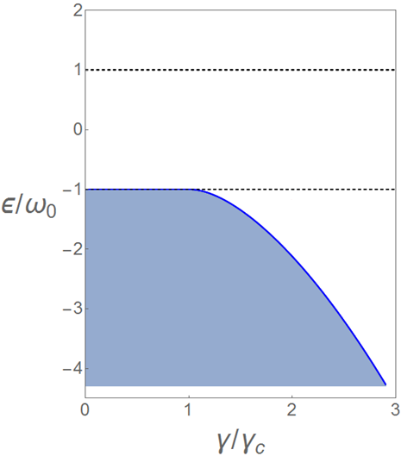
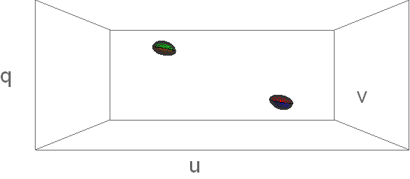
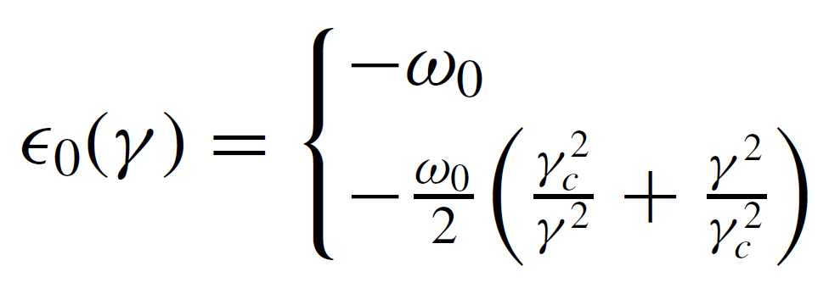
Energy Shell and coupling
Dashed lines are the energies of the ESQPT.
For 2γ_{c}, ω = ω_{o} and p=0
Normal phase
Superradiant
phase
ESQPT!!
ESQPT!
Blue line is the minimal energie as function of the cupling factor (γ /γc).

Slide 13
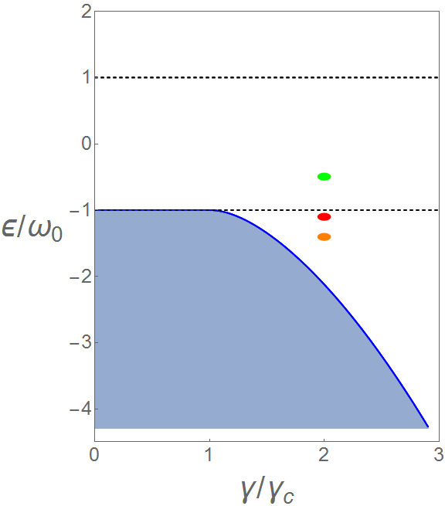
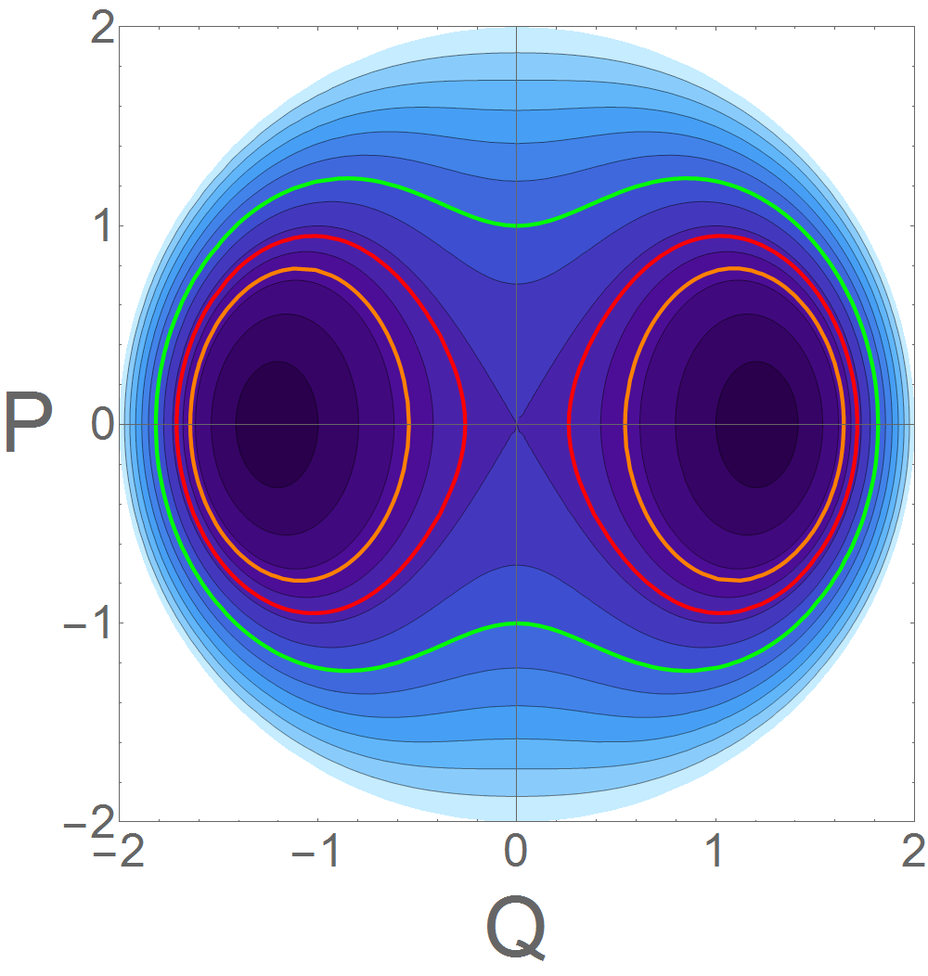
Energy Shell and coupling
Dashed lines are the energies of the ESQPT.
For 2γ_{c}, ω = ω_{o} and p=0
Energy shell
ε = -0.5ωo (Up)
ε = -1.1ωo (Center)
ε = -1.4ωo (Down)

Slide 14
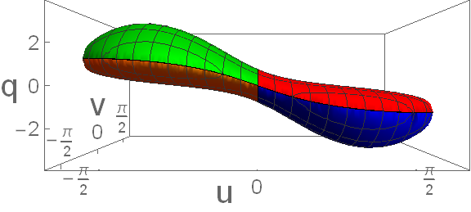
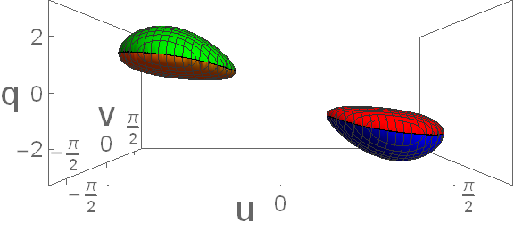
Energy Shell and coupling
For 2γ_{c}, ω = ω_{o} and p=0
Energy shell
ε = -0.5ωo (Up)
ε = -1.1ωo (Center)
ε = -1.4ωo (Down)

Slide 15
Classical dynamics

Slide 16
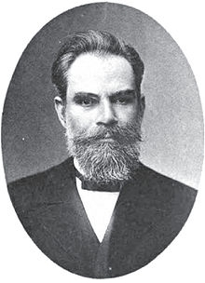
Lyapunov exponent
For a perturbation δx0 of x0 that evolves as |δx(t)|
In a trayectory: |δx(t)| ≈ e^{λt} |δx0|
x(t)
δx(t)
δx0
x(t)+δx(t)
λ is call Lyapunov exponent
λ = 0 “Regular”
λ < 0 “Regular” y “Attractor” CUANTITATIVE method!
λ > 0 “Chaos”
t_{λ} = 1/ λ (Lyapunov time)
M. A. Lyapunov, The general problem of the stability of motion (in Russian). Kharkov Mathematical Society 250 pp (1892).
Ch. Skokos, The Lyapunov Characteristic Exponents and Their Computation, Lect. Notes Phys. 790, 63-135 (2010).

Slide 17
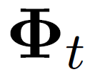
Variational equations
Dynamical Equations (d-Dimensions)
|
|
†
.
Fundamental Matrix or Monodromy matrix (d²-Dimensions)
2
Variational Equations variacionales
Coupled set of d(d+1) differential no-linear equations.

Slide 18
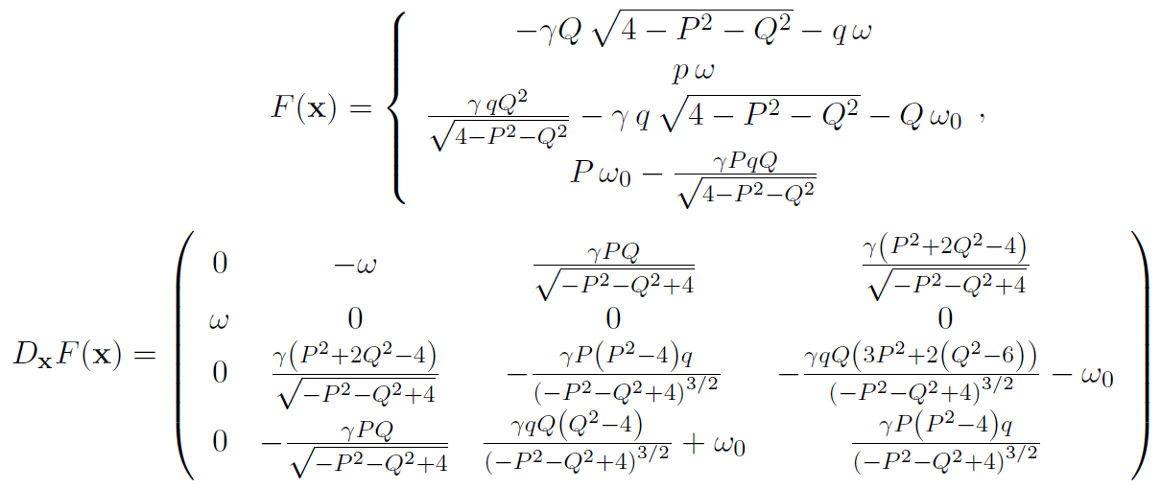
LE in the Dicke model
d = 4 → 20 Non-linear differential equations
Numerical methos used to solve it

Slide 19
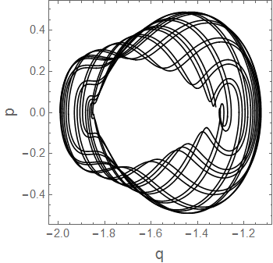
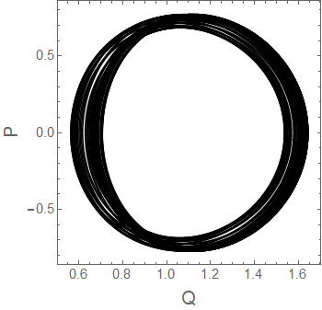
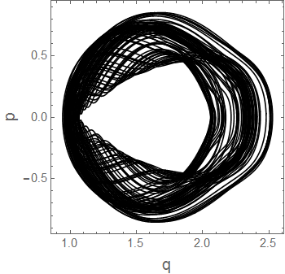
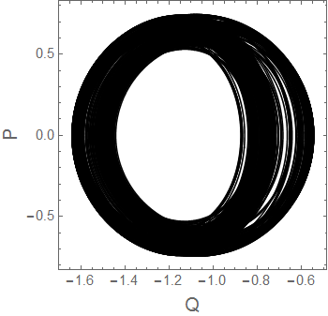
For 2γ_{c}, ω = ω_{o} and ε = -1.4ω_{o}
Regular
Chaos
1
2

Slide 20
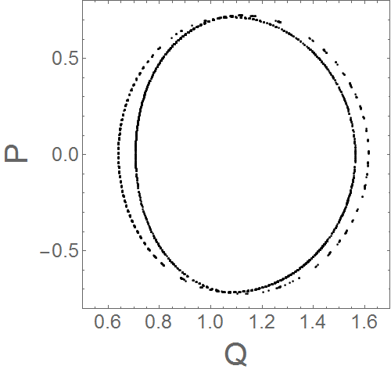
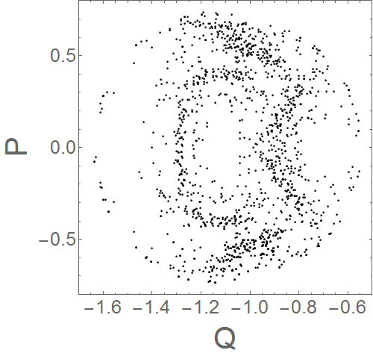
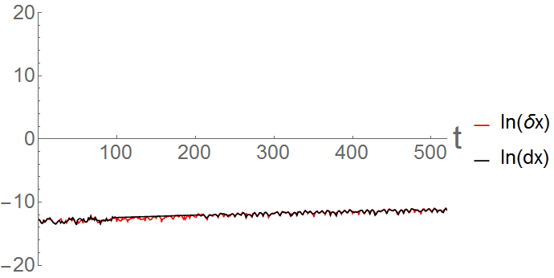
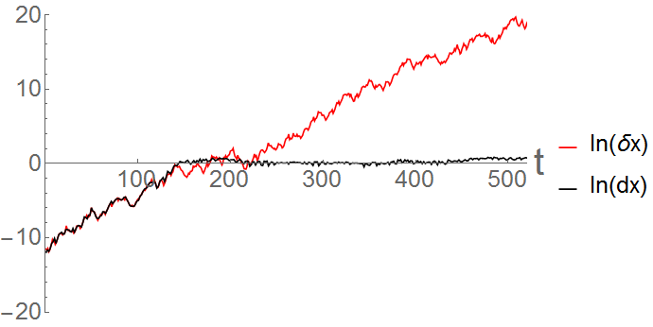
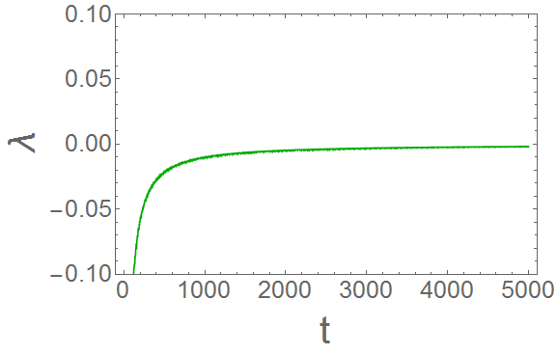
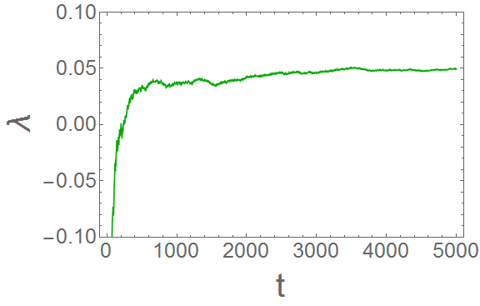
For 2γ_{c}, ω = ω_{o} and ε = -1.4ω_{o}
Regular
Chaos
λ = 0.051
λ = 0.001
λ ≤ 0.003 Regular numerically

Slide 21
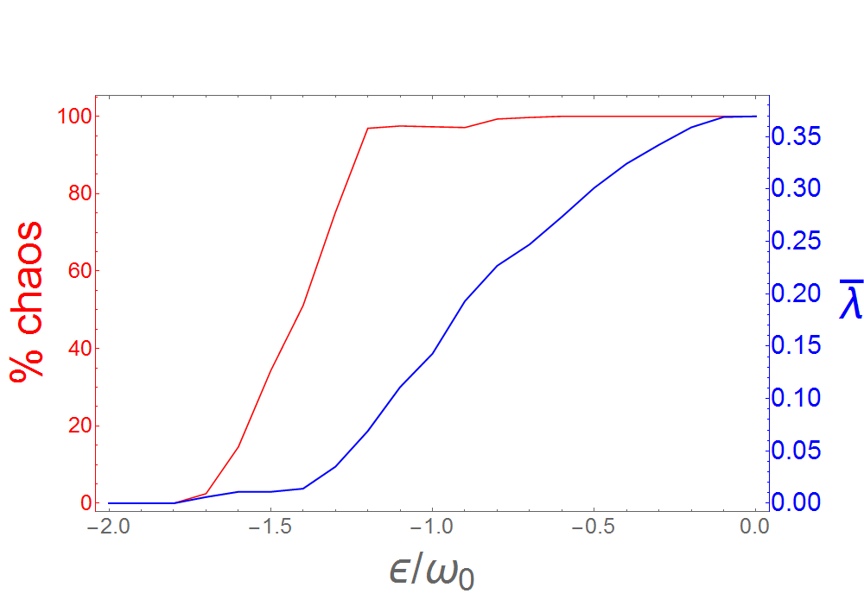
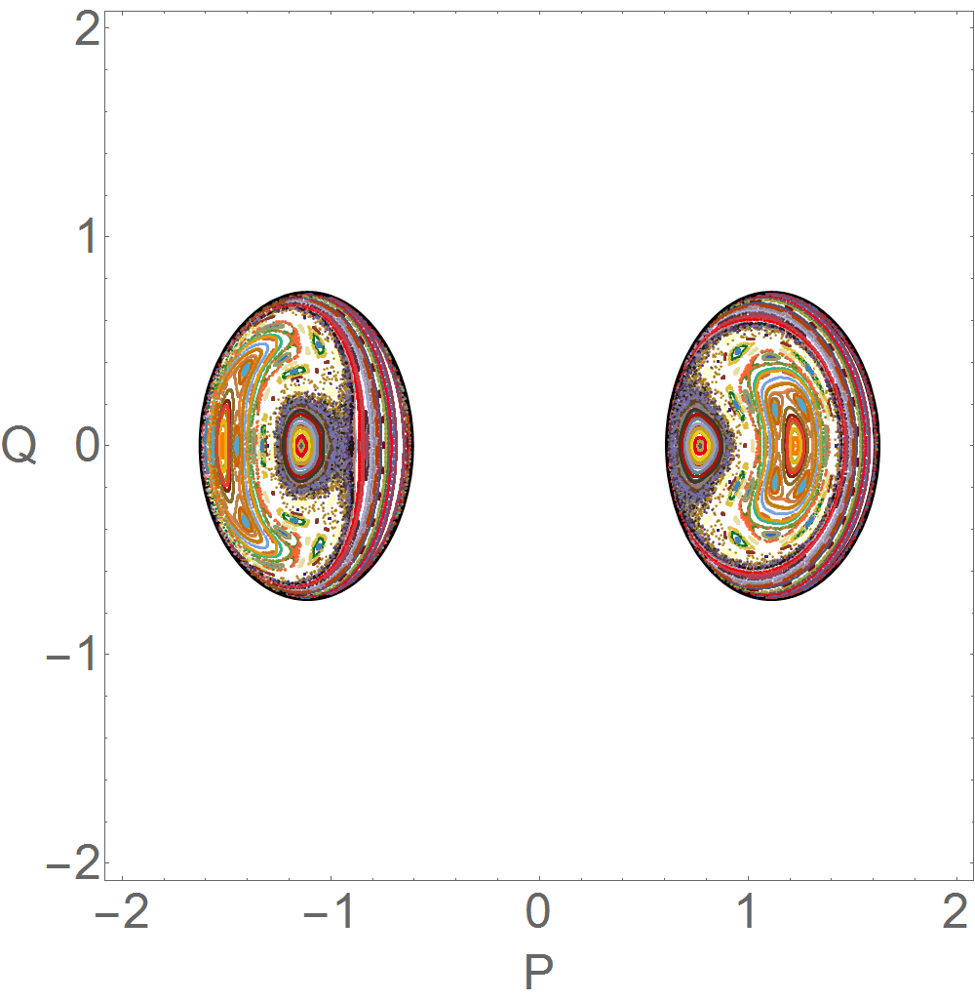
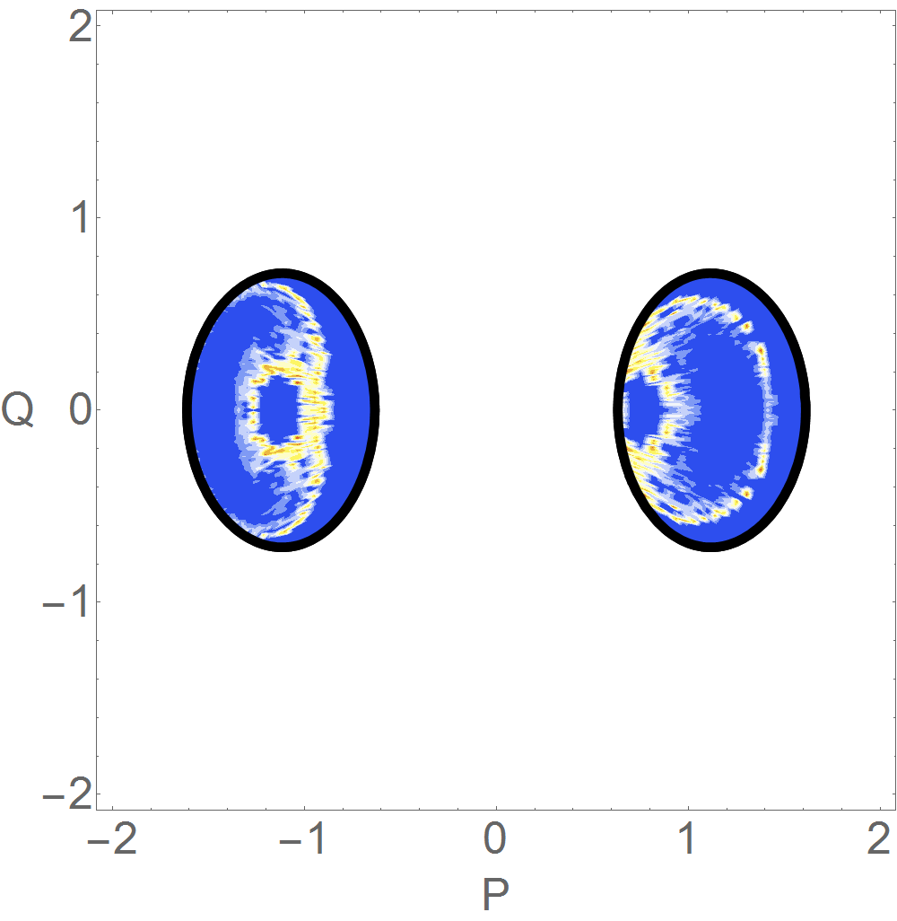
Percentage of chaos and average of the LE in phase space
For 2γ_{c}, ω = ω_{o}
ε = -1.4ω_{o}
Poincaré section
Island of stability
20% of chaos
Lyapunov Exponent
Average
LE: 0.015

Slide 22
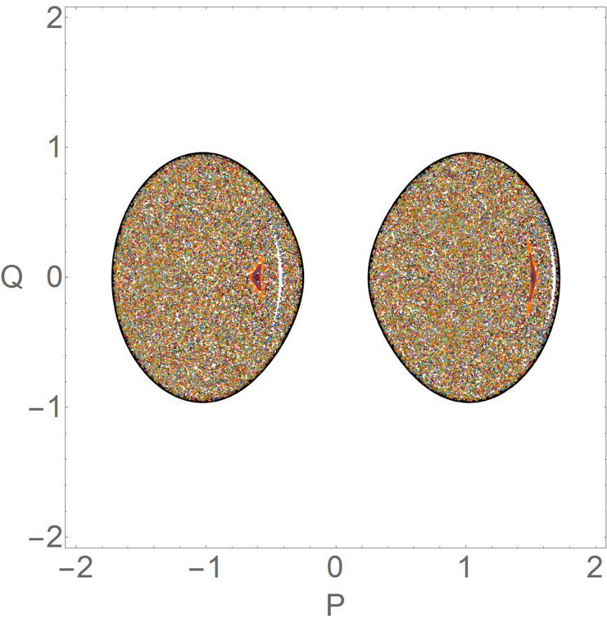
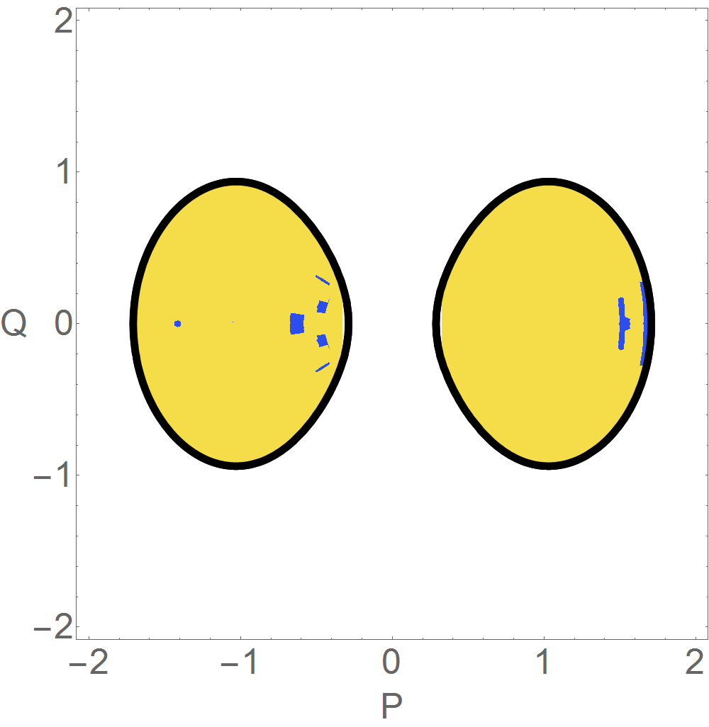
Percentage of chaos and average of the LE in phase space
For 2γ_{c}, ω = ω_{o}
ε = -1.1ω_{o}
Poincaré section
Small island of stability
97.1% of chaos
Lyapunov Exponent
Average
LE: 0.111

Slide 23
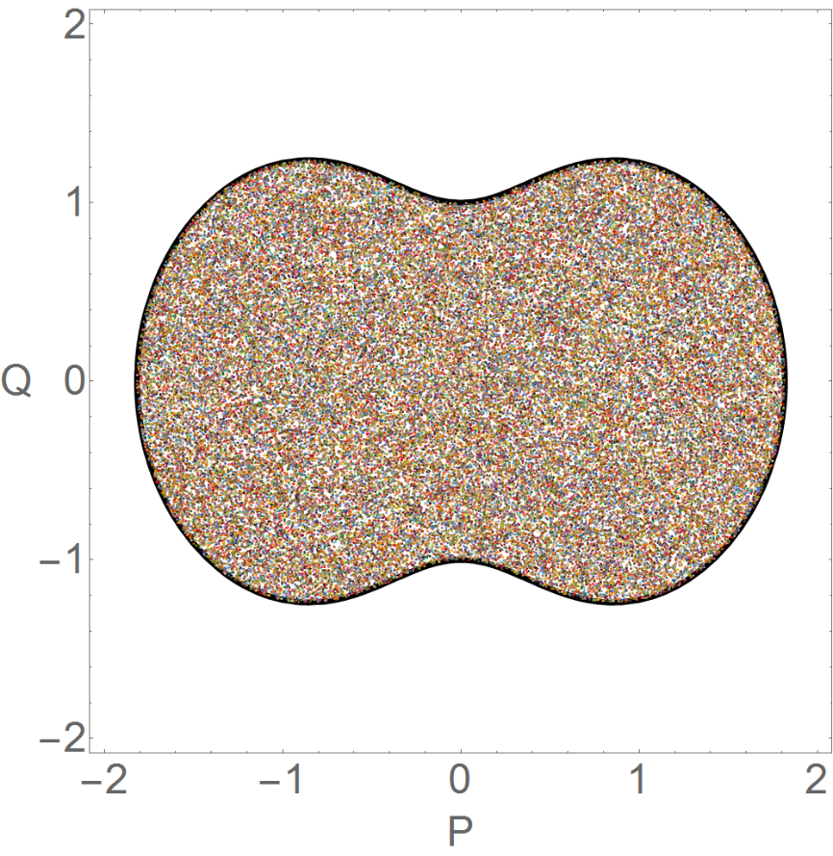
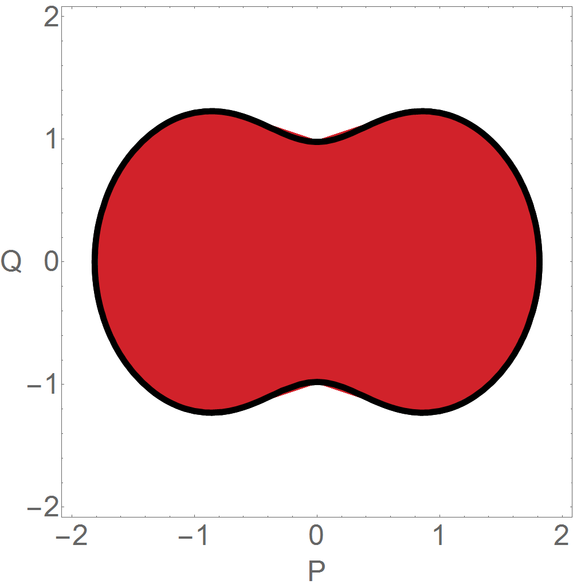
Percentage of chaos and average of the LE in phase space
For 2γ_{c}, ω = ω_{o}
ε = -0.5ω_{o}
Poincaré section
Ergodic Chaos
100% of chaos
Lyapunov Exponent
Average
LE: 0.301

Slide 24
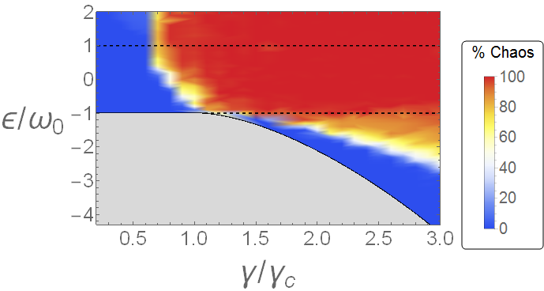
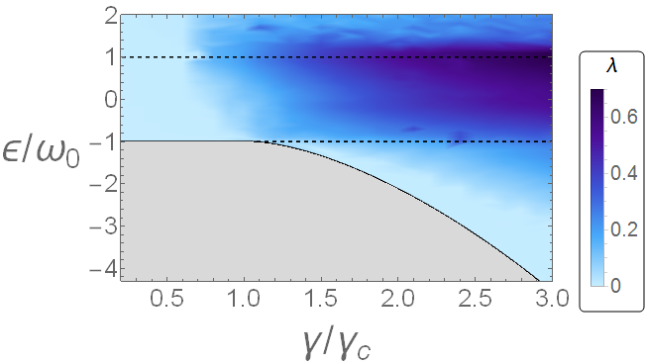
Maps of porcentage of chaos and average of the LE in phase space*
ω = ωo (more common case)
Chaos becomes arround the ESQPT and for high energies also small couplings less γc
*J. Chávez-Carlos, M. A. Bastarrachea-Magnani, S. Lerma-Hernández, and J. G. Hirsch, Phys. Rev. E 94, 022209 (2016).

Slide 25
3. Homework

Slide 26
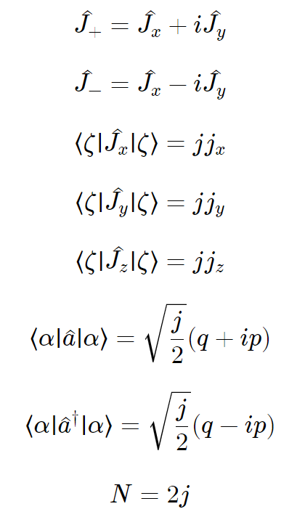
Exercies:
1. Using the next properties, proof the classical Hamilton (Hint: Use polar coordinates in the Pseudospin variables)
2. Improve the code of mathematica just to get the Lyapunov exponent numerically, using the language of your preference

